Slide 1

Sarcopenic Obesity is Part of Obesity Paradox in Dementia Development Evidence from a Population-Based Cohort Study
Authors: Zhang et al. BMC Medicine 2024
Presented by: Amirmoein Vafaie
advisor: Dr. Aminalroaya
1
1404/10/15

Slide 2

LearningObjectives
Define sarcopenic obesity and obesity paradox
Quantify dementia risk vs obesity alone
Interpret sex-specific HRs
Explain dementia-onset timing curves
Identify brain-volume mediators
2

Slide 3
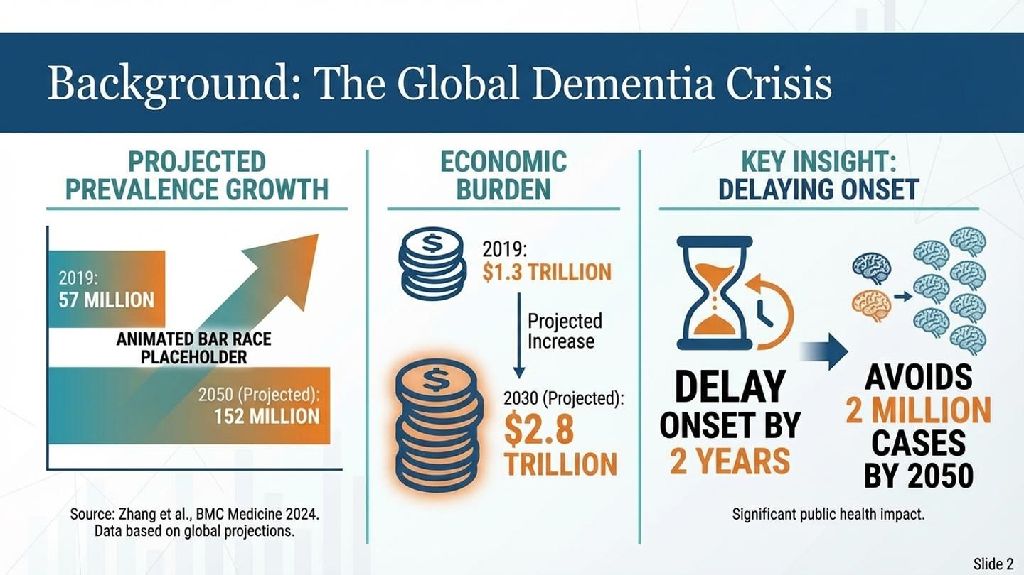
3

Slide 4
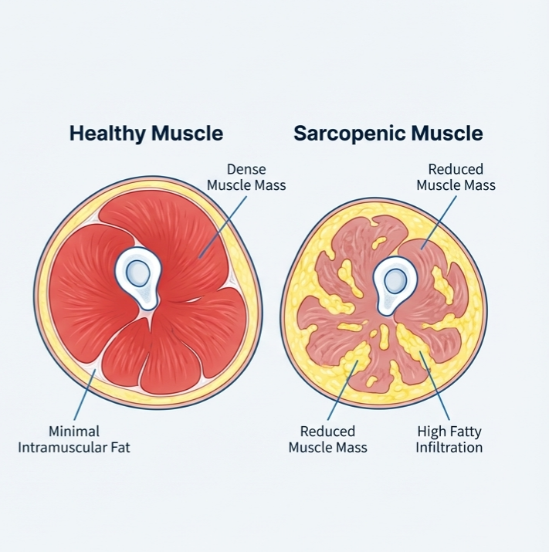
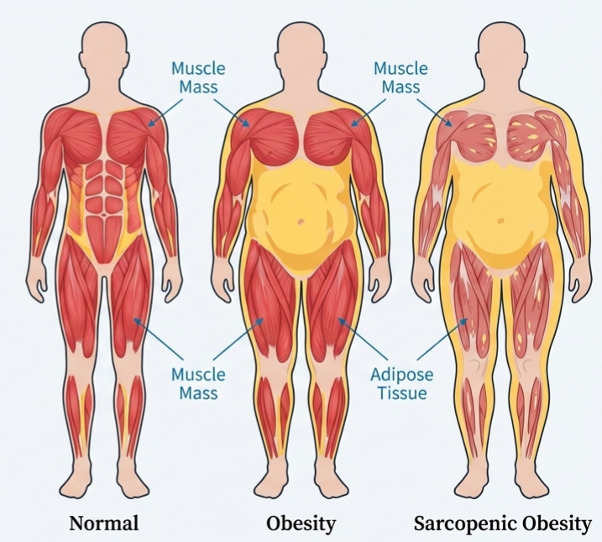
4

Slide 5
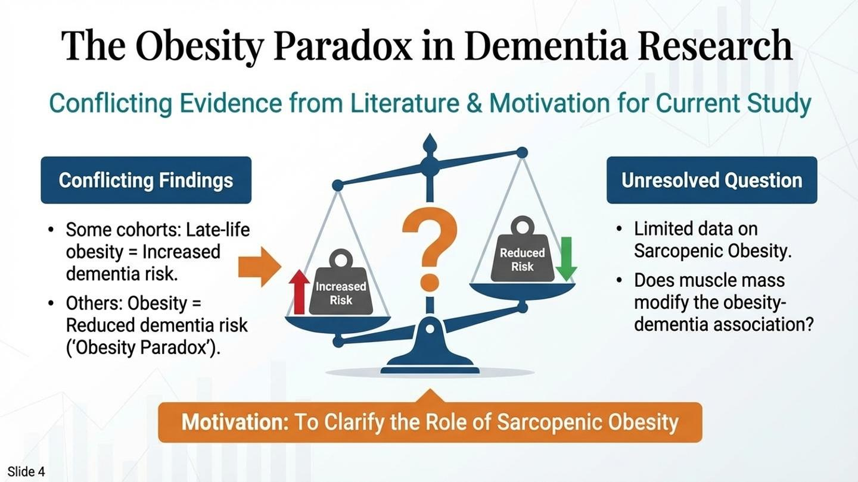
5

Slide 6
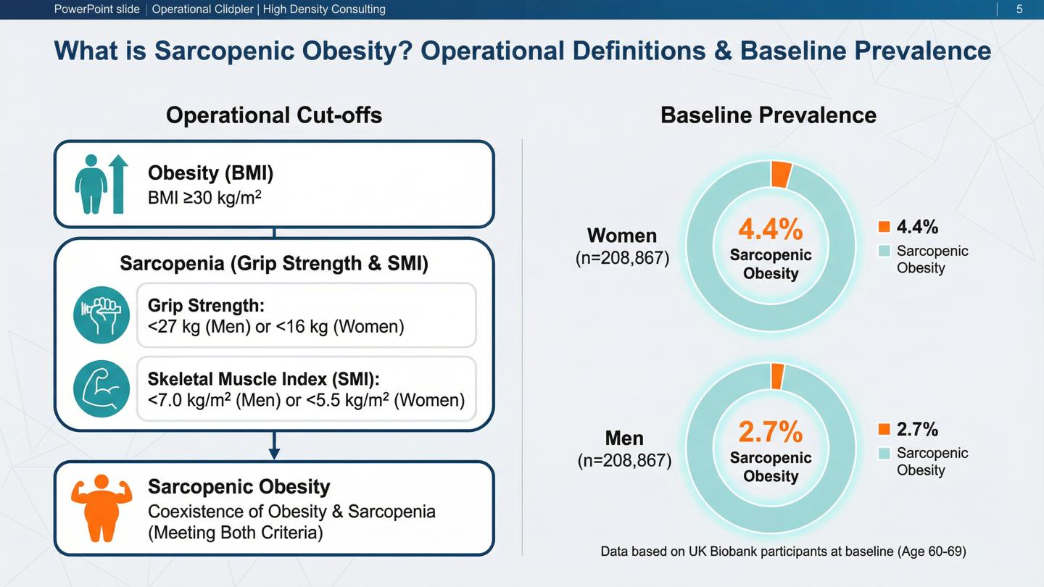
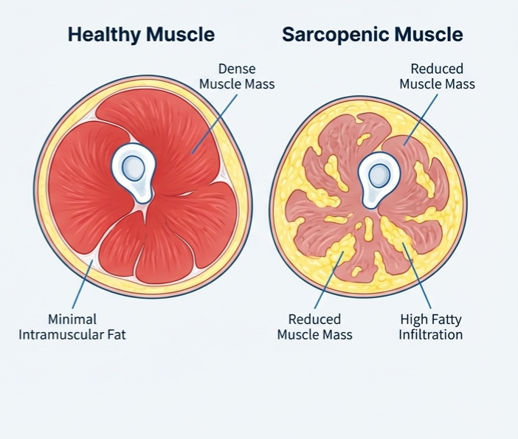
6

Slide 7
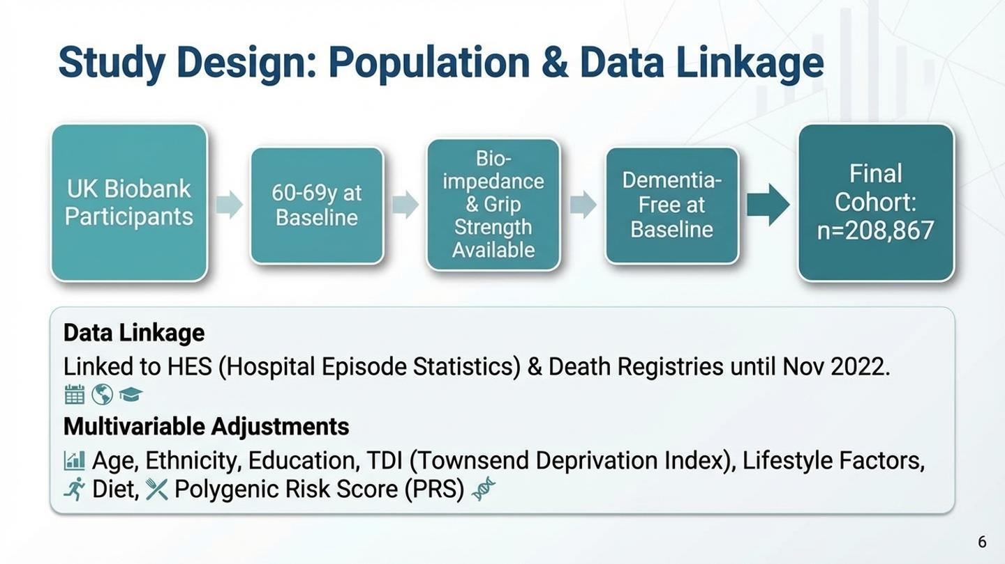
7

Slide 8
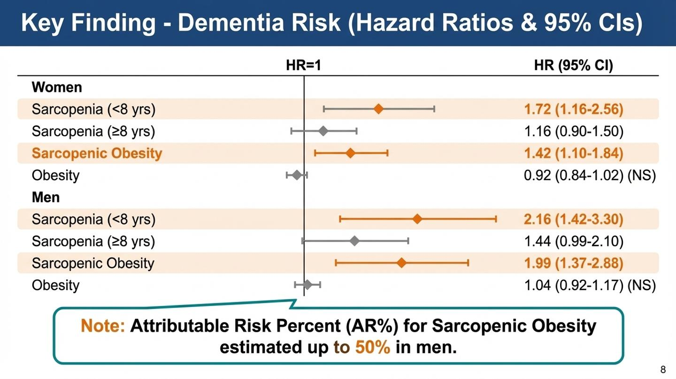
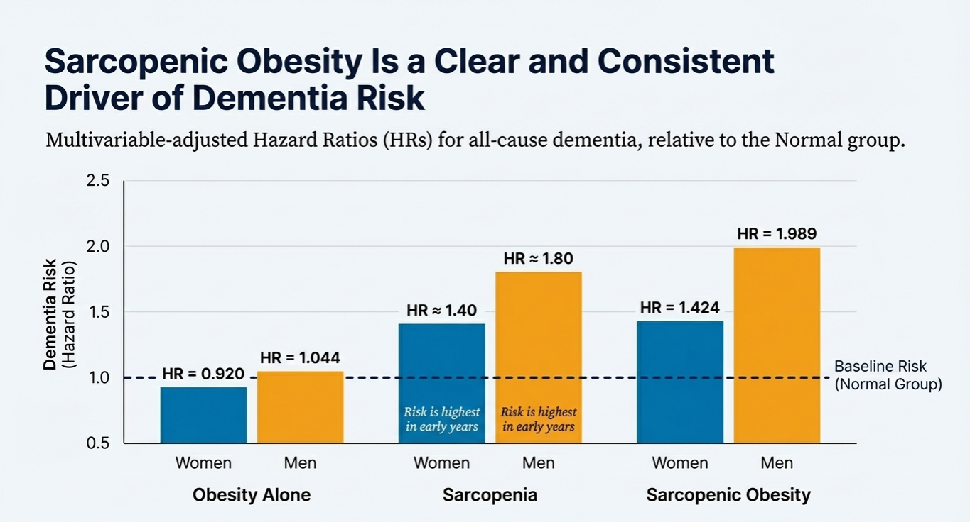
8

Slide 9
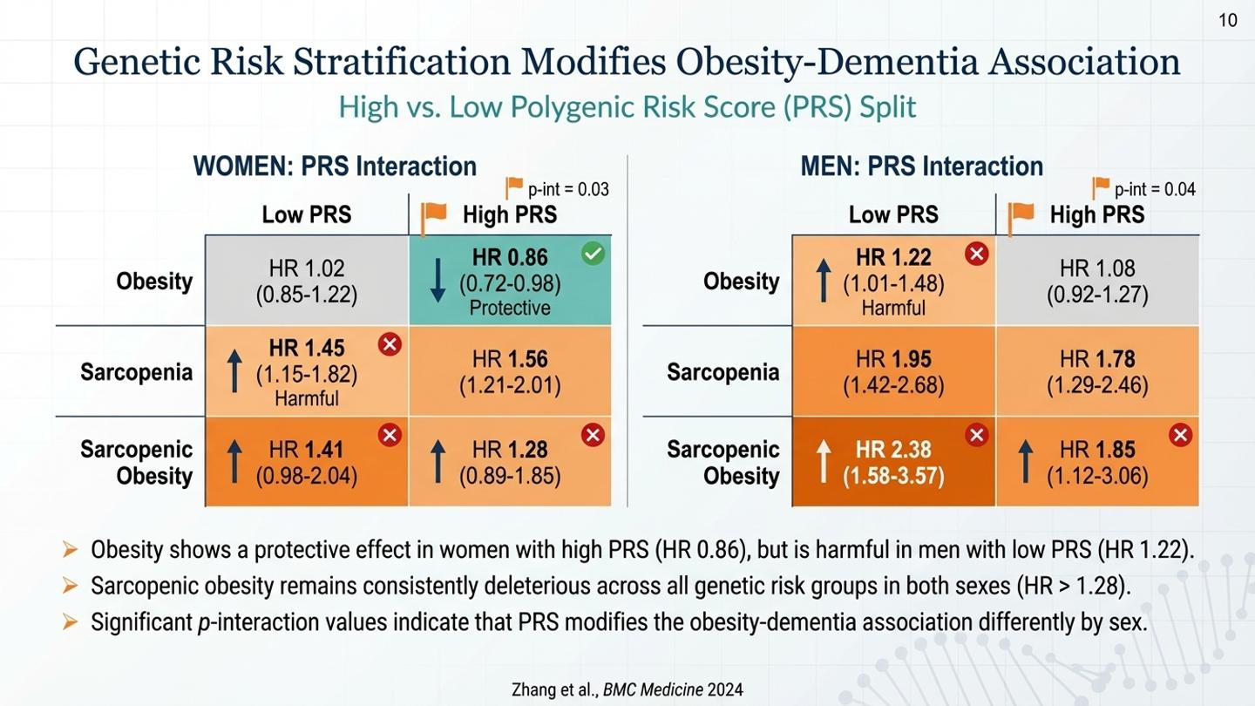
9

Slide 10
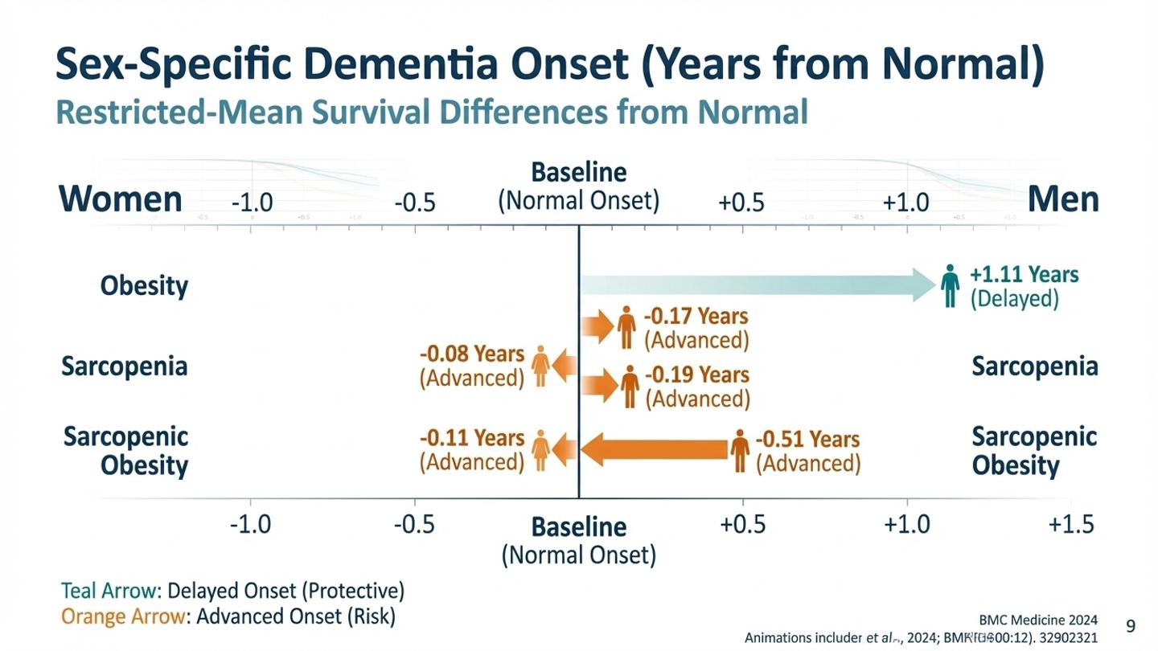
10

Slide 11
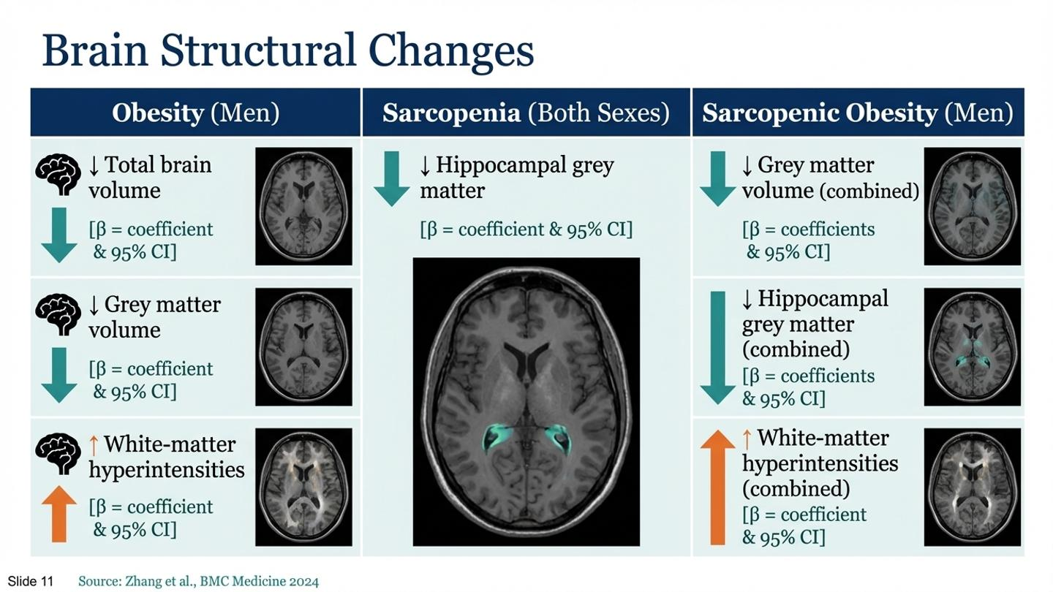
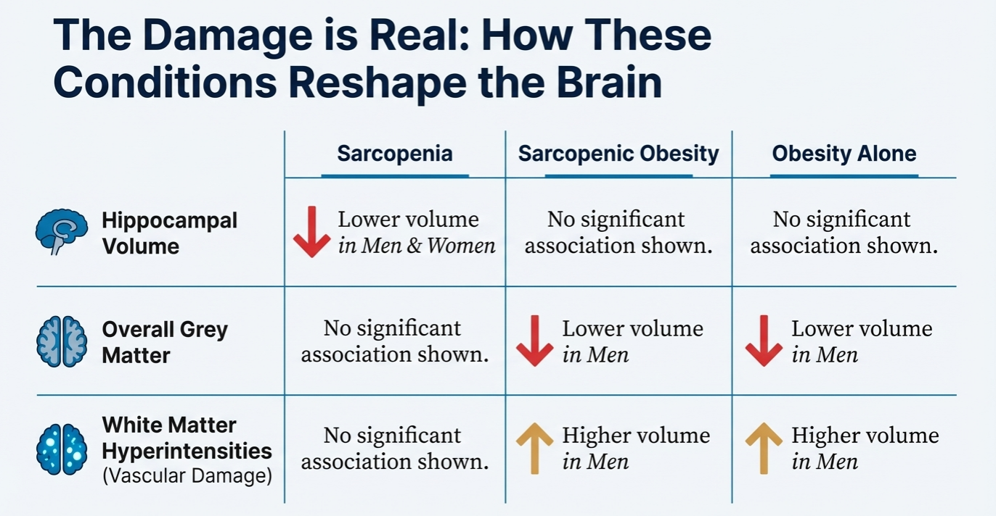
Sarcopenia in women results: Larger volumes of total brain and white matter, suggesting neuroprotection.
11

Slide 12
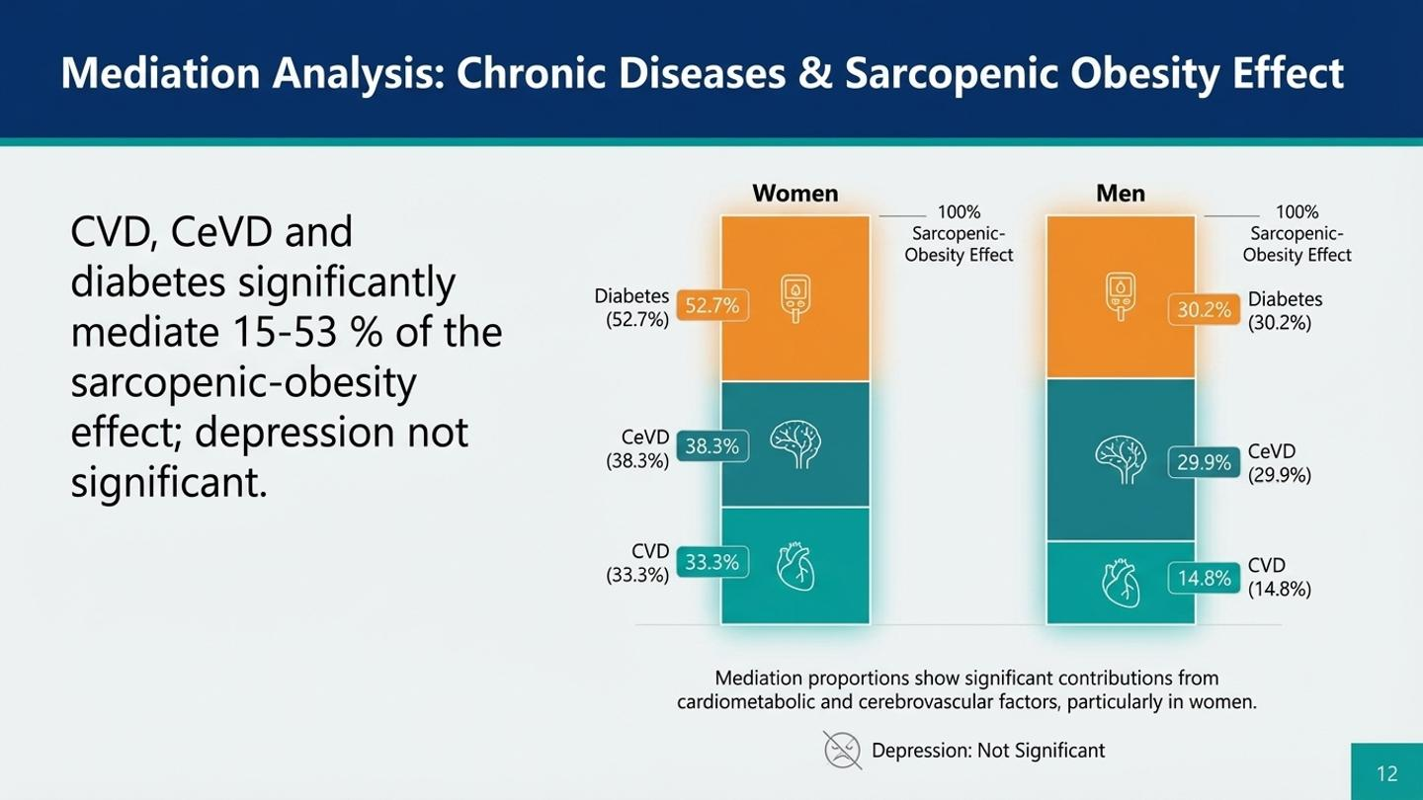
12

Slide 13
Why?
13

Slide 14
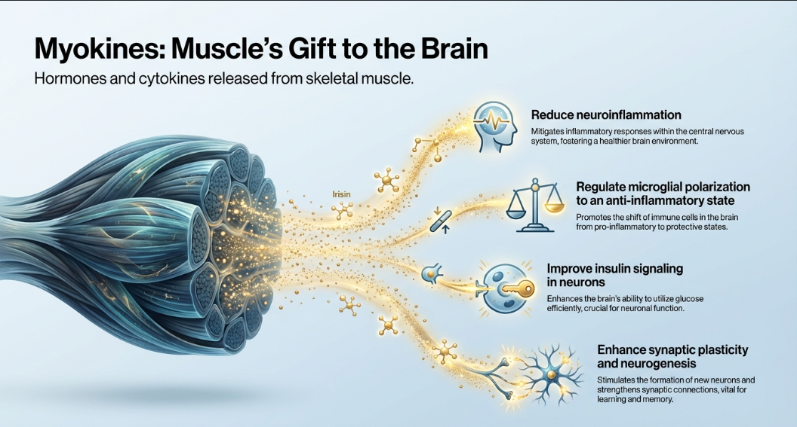
14

Slide 15
Irisin is a key myokine strongly linked to muscle health
Released during muscle contraction and exercise
Functions:
  Increases BDNF expression in the hippocampus
  Promotes neurogenesis and memory formation
  Provides neuroprotection
Irisin: The Central Myokine
15

Slide 16
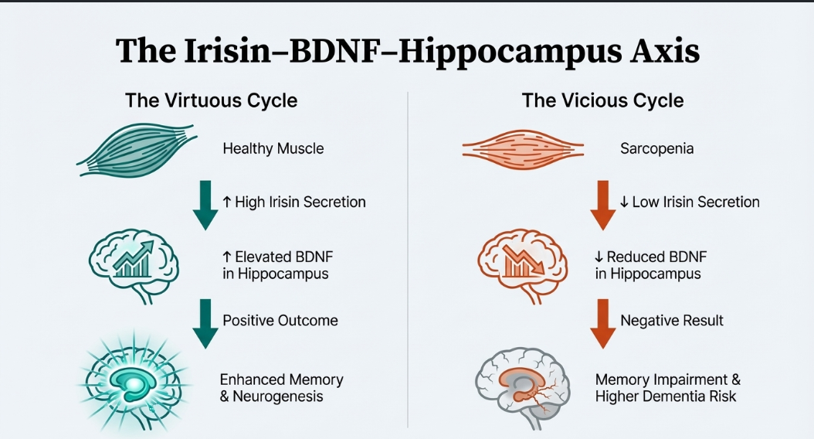
16

Slide 17
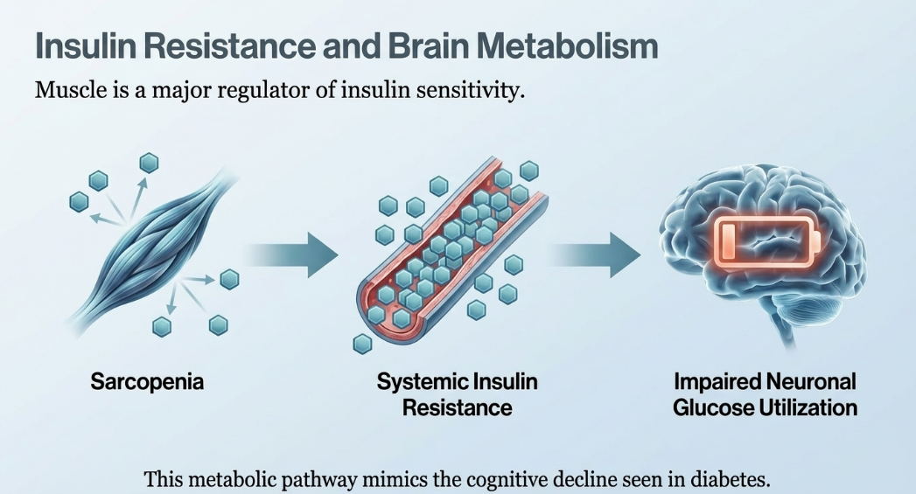
17

Slide 18
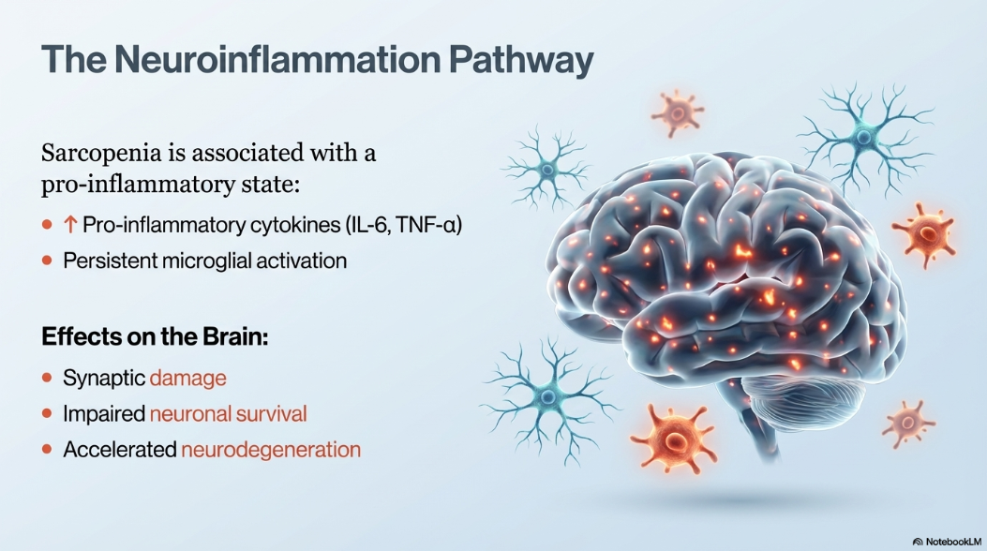
18

Slide 19
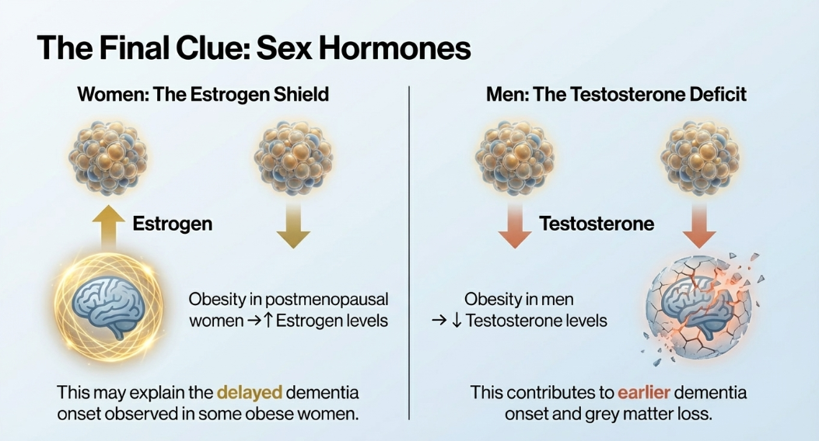
19

Slide 20
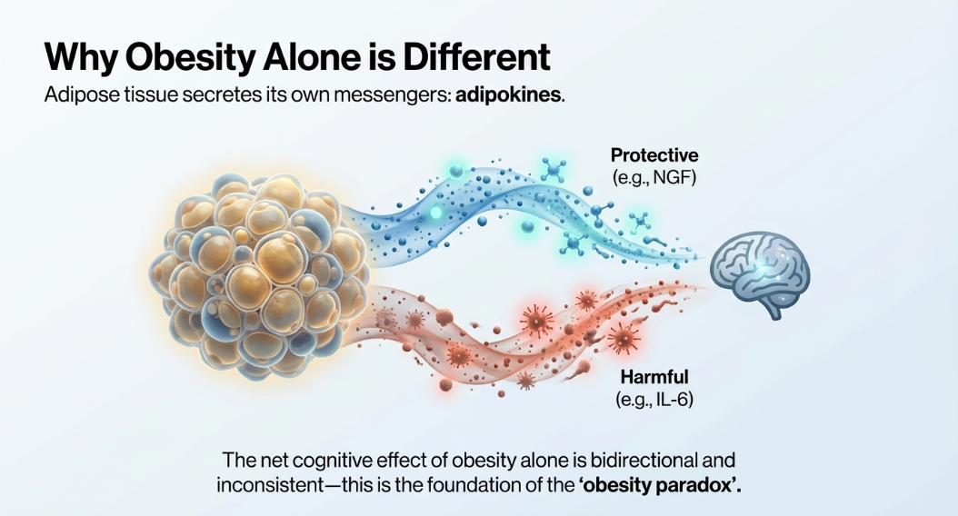
20

Slide 21

Key Takeaway
This study challenges the traditional focus on weight loss alone for dementia prevention and emphasizes the critical importance of enhancing and maintaining muscle mass and strength through a balanced diet and adequate resistance training.
Resistance Training
Balanced Diet
Chronic Disease Control
22

Slide 22
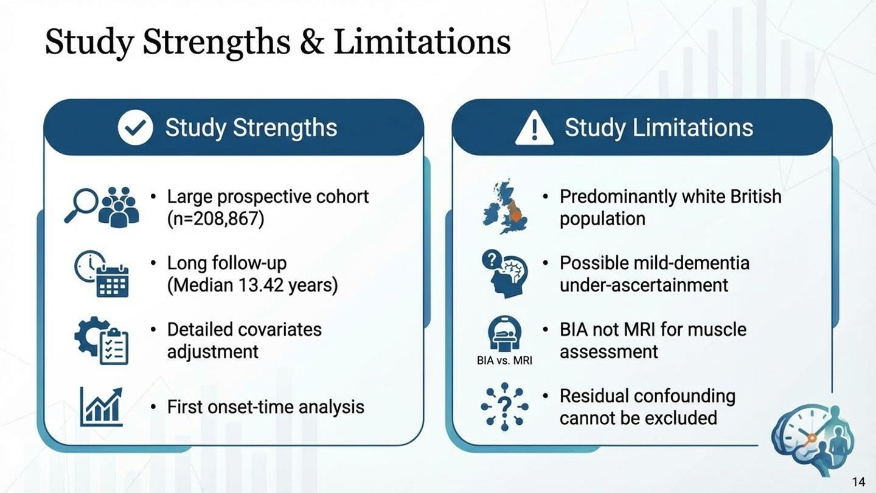
23

Slide 23
FURTHER DISCUSSION
Discussion Questions
1
Understanding Sarcopenic Obesity
2
Sex Differences in Obesity Effects
What is sarcopenic obesity, and how does it differ from obesity or sarcopenia alone? Why might the combination be more harmful?
How do sex differences affect the relationship between obesity and dementia risk? What biological mechanisms might explain these differences?
3
Potential Biological Mechanisms
4
Importance of Muscle Mass
What are the potential mechanisms linking sarcopenic obesity to dementia risk? Consider roles of adipokines, myokines, and inflammation.
Why is maintaining muscle mass important for cognitive health? How might myokines like irisin protect against dementia?
5
Public Health Implications
What public health interventions could target sarcopenic obesity? How might this change current dementia prevention guidelines?
Application Challenge
How could you apply these findings in your own work or community to help prevent dementia?

Slide 24

Thank you!

